Slide 1

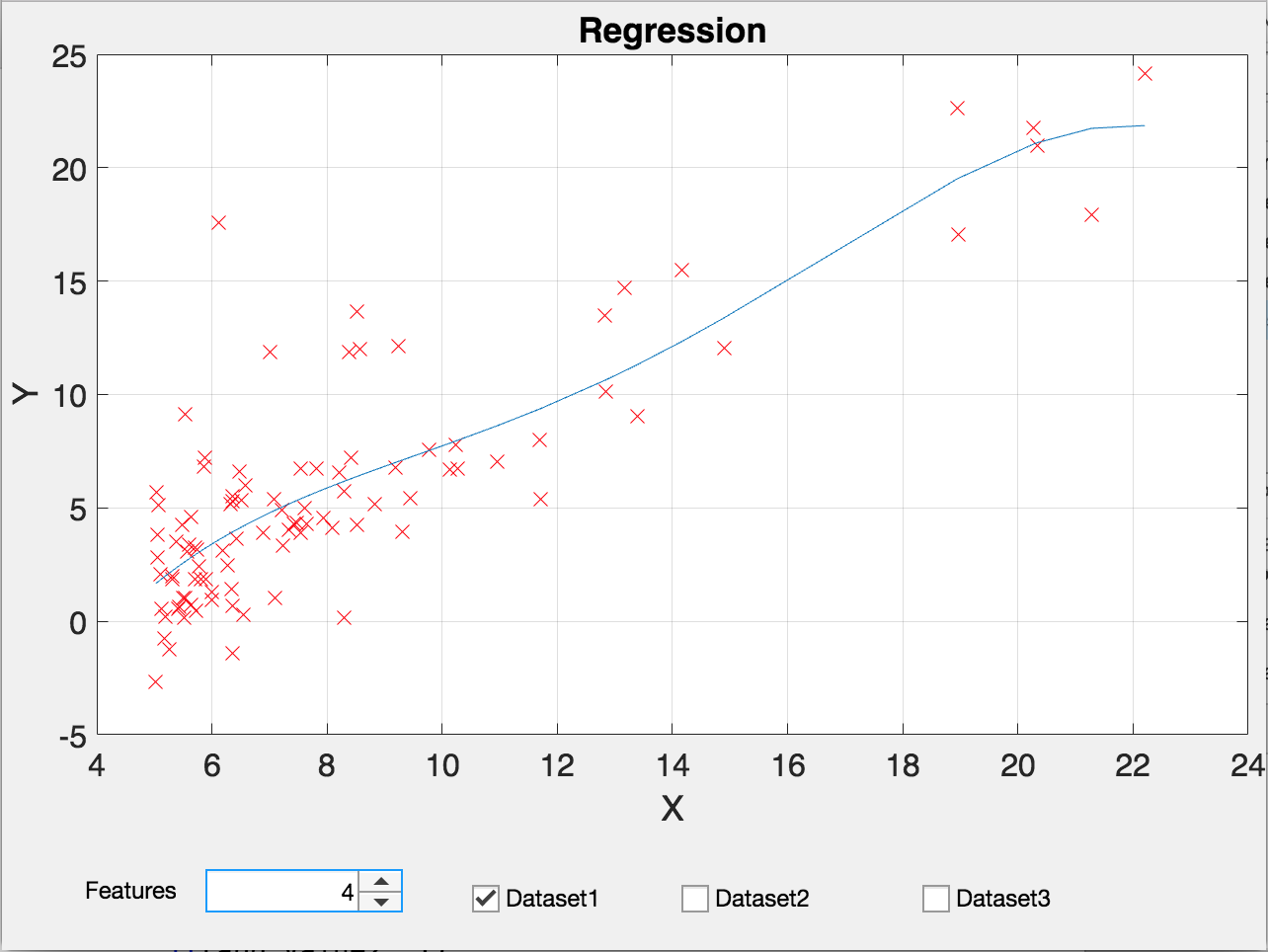
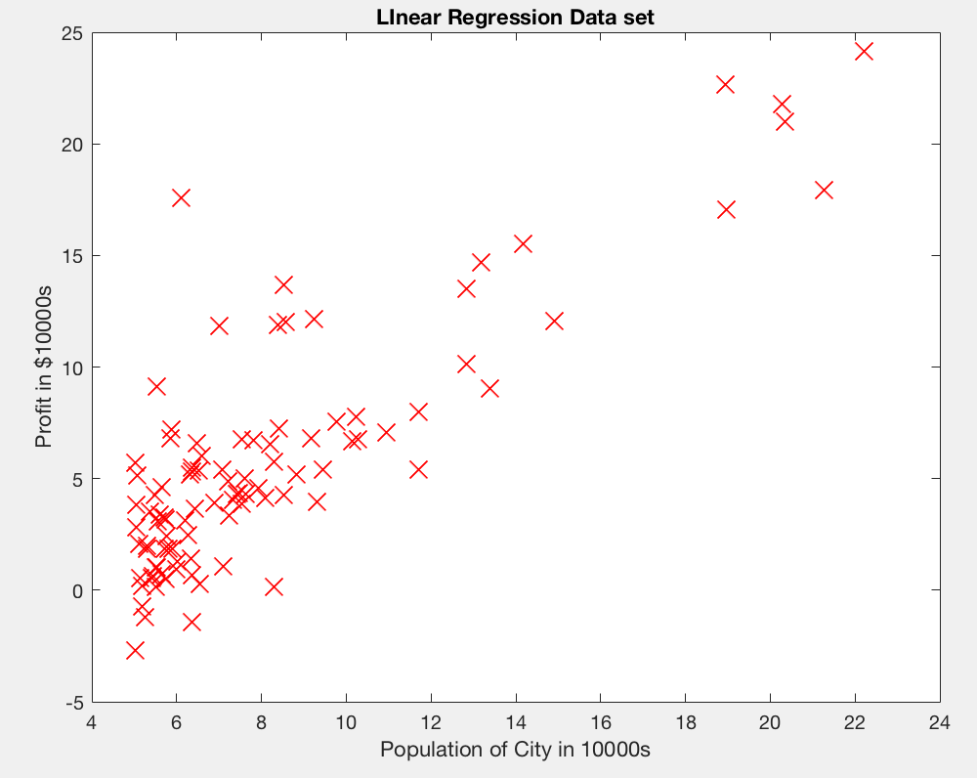
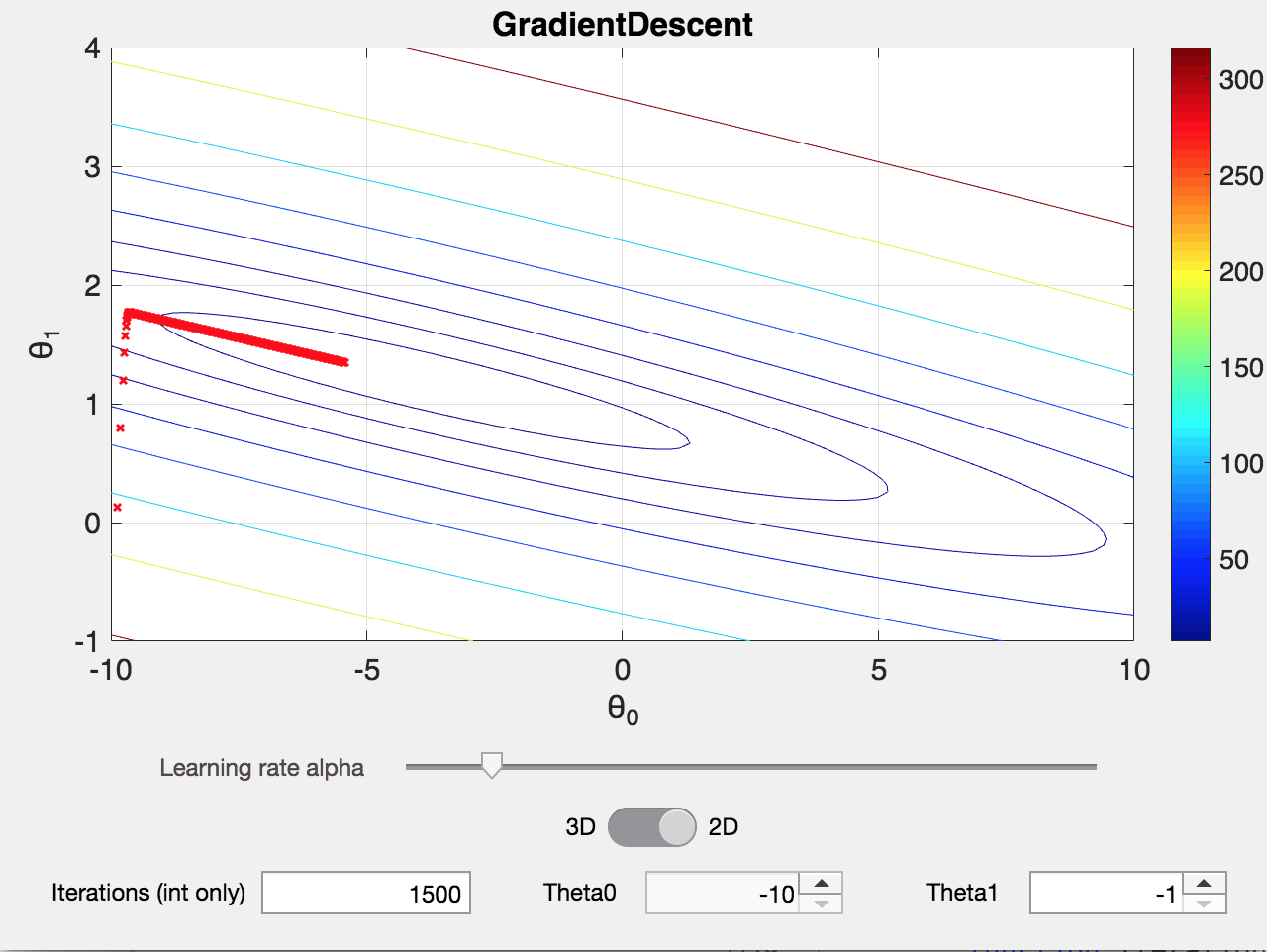
Machine Learning Workshop Development
Arielle Blum; Xucheng You
University of Colorado at Boulder, College of Engineering and Applied Science
Abstract
Methods and Materials
Figure 3. Regression Animation Interface
This project is about developing a machine learning workshop for absolute beginners. Our goal is to bring up students’ interest in machine learning by introducing them basic concepts of machine learning without involving much math. In order to do that, we started with basic algorithm related to regression in machine learning, and created two animations using multiple tools(MATLAB, Tensorflow) over the year to help students who attend the workshop understand definitions of parameters in algorithms and how to choose their values when implementing algorithms.
The main tools we used to design and implement interface and algorithm are MATLAB App Designer and Tensorflow.
In the app designer, the figure window, checkboxes, variable input windows, switch and value slide bar are pre-set models we could use in the interface, it creates an “object” in the lower level coding tab, then it could be programmed like other objected oriented languages, to let the plot update itself when one of the variables is changed. The algorithm functions are implemented as well, so we could call and run through them once the variable is updated.
In Tensorflow, we started another animation related to earthquake using real data from USGS(US Geological Survey). The purpose of this is to show students machine learning’s usefulness in real life. A three layers neural network is used as the model, but this part is still in debugging status so we haven’t used it in our workshop test run so far.
Introduction
Results
Discussion
At the start the project, we decided to start the first workshop with gradient descent and linear regression because it’s the simplest and most commonly used algorithm for data fitting and data prediction problems. we first selected a “population in city-real estate profit” dataset for algorithm testing and we used the same dataset later for our animations as well. The dataset are shown in the figure 1 below. Without much math involved, the way we approach algorithm is let students understand machine learning variables with the concept they already know(ex. slope, intercept, converge, etc.). Using analogy also help them understand the new concepts like cost function based on similar tools they used before (ex. trend-line function).
First Animation: The interface consists of a contour plot, a color bar indicates the cost function values, a 2D-3D switch, a slide bar and three value input windows. Students have control over parameters including learning rate, iterations, theta0 and theta1(the starting theta values chosen.) They are also able to select the view of the plots, both 2D and 3D.
Second Animation: The second animation is about linear regression built based on the gradient decent algorithm in the first one. With the gradient descent algorithm they learned, they are able to find best theta values for other data sets as well. So in this second animation, students are given the flexibility of changing dataset and number of features(number of theta variables used) to find the best curve that fits the data points.
After doing a workshop test run at the end of this project, we found some potential improvements that could be done next year. For example, instead of only having data points/variable values changing over the iterations, we would have those values printed on the plot at the end of the algorithm to help students see how close their results are to the center point (optimized values). Another improvement would be having the variables’ update process better explained by having negative example showing how the wrong procedure would affect the time consumed to reach the same result. For further improvements, we would involve more advanced and interesting topics in our workshop, for instance, facial recognition, hand written recognition, students are more passionate about seeing real-world related results rather than just plots.
Figure 1.Data set used for first two animations
Figure 2.Gradient Descent Animation Interface
Conclusions
With the first stage workshop designed and beta tested. The project will continue next year and be further improved based on the feedback. Here are the next steps: The first stage workshop would run couple of more times at the start of next semester with lager groups of students in order to get a sense of how well students could understand material and get feedback from them. Then, because more advanced topics will be involved in second/third stage workshops, new animations will also be made using other algorithms(ex. neural network). The platform is still to be determined.

